Slide 1
IsotopesAu
Direct Data Upload
Using the Upload Wizard

Slide 2
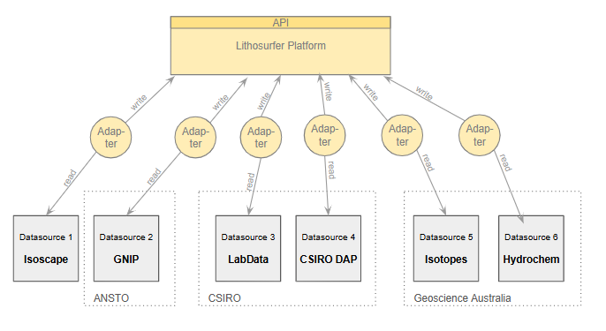
Current Data Upload via Adapters

Slide 3
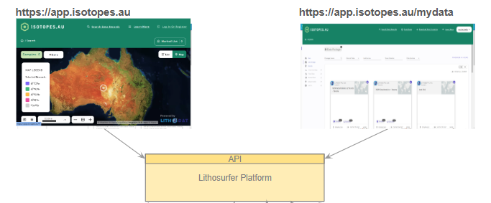

Direct Data Upload in the Data Section
Specialized
Isotope
Section
Data Section
Click

Slide 4
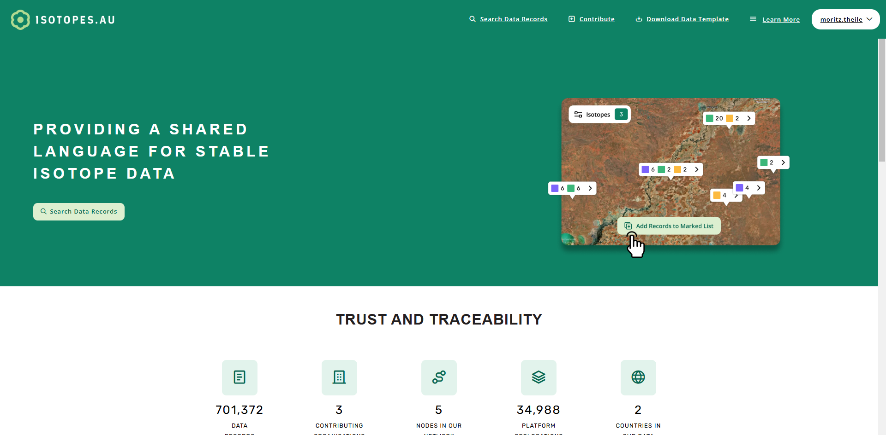
Live Demo

Slide 5
Preparing a Wizard Upload Workshop
Template?
Data?
Preparing Accounts
…

Slide 6
Thanks!

Slide 7
Demonstration of Direct Data Upload
UI sections
Specialised Section (e.g. map to visualize isotope data)
Data Section (generic, all data can be handled)
Data Packages (Package per Project)
Teams
Data Package States
PRIVATE
PUBLIC
Data Browsing

